Slide 1
Playing to Win: Exploring the Causal Relationship between Game Features and Positive User Feedback in the Steam Marketplace
Timothy Toth

Slide 2
What Impacts Positive Ratings for Video Games in the Steam Marketplace
The video game industry has experienced tremendous growth in recent years
Positive ratings on Steam are critical for a game's success, as they can influence a potential buyer's decision to purchase the game. 86% of players report paying attention to review scores
Therefore, understanding the factors that impact positive ratings on Steam is crucial for developers seeking to improve or forecast their games' sales and success.

Slide 3
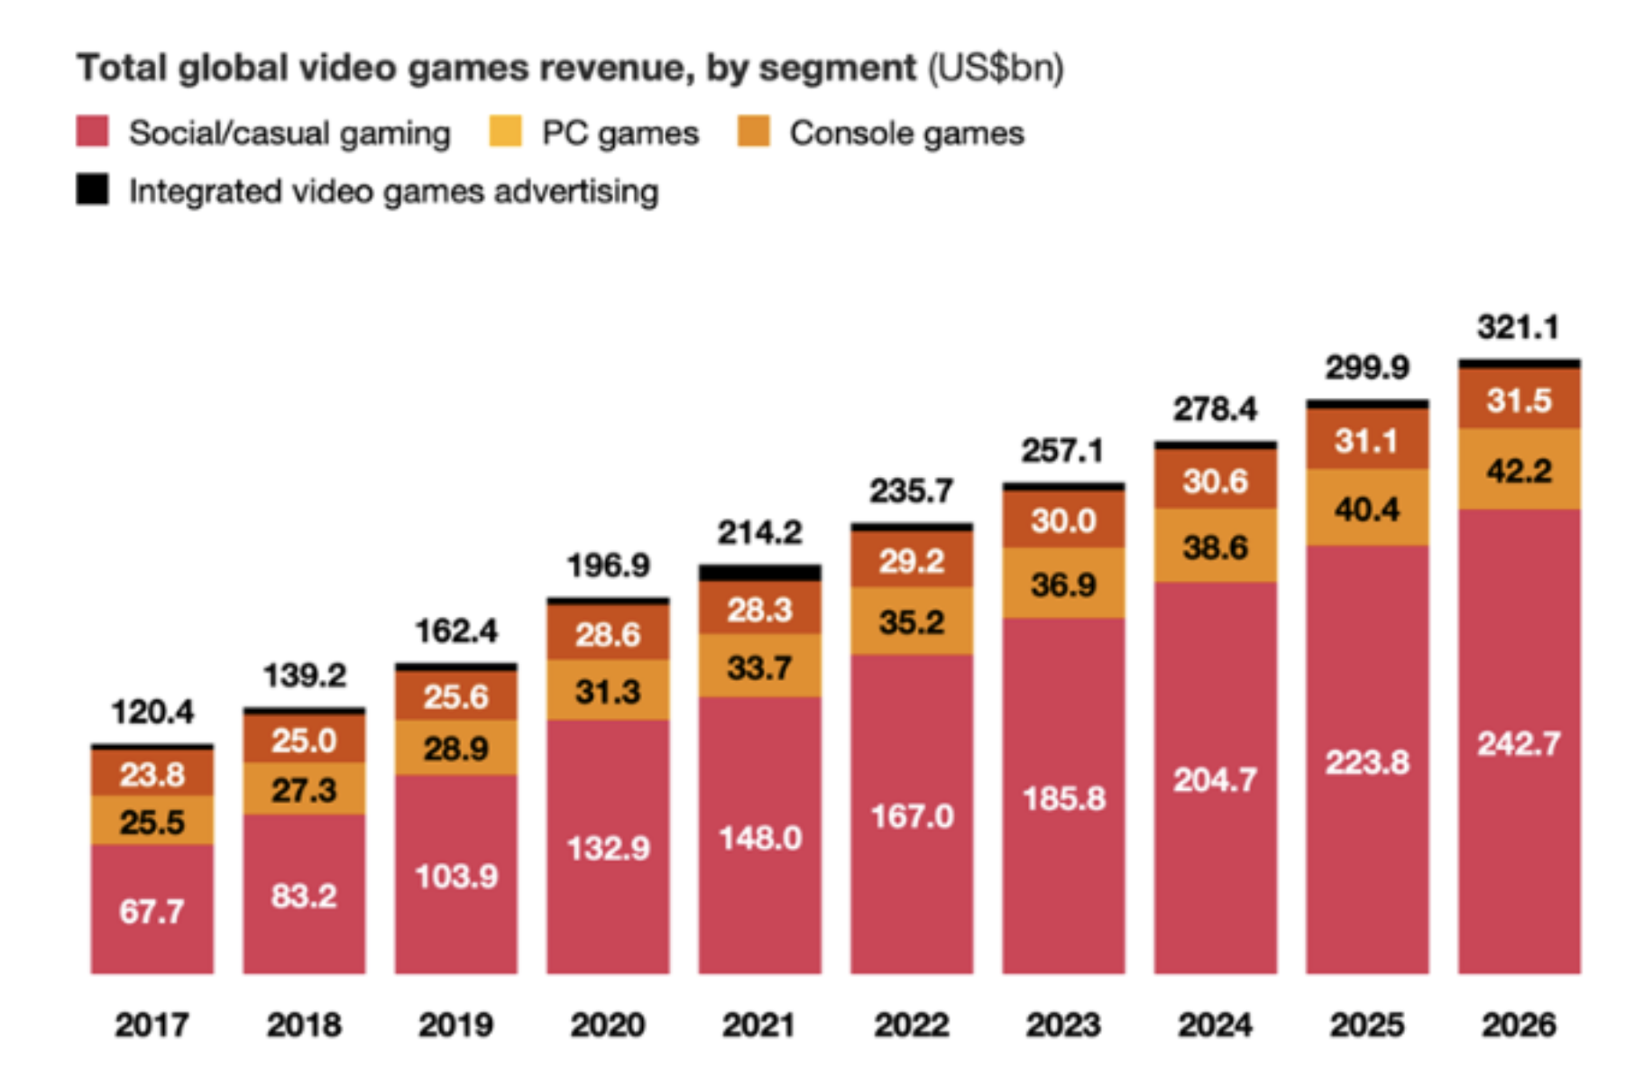

Slide 4
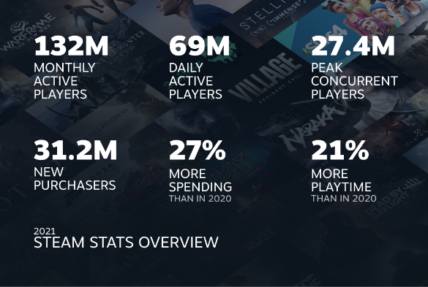
What is Steam?
Steam is the largest digital distribution platform for PC games, with over 120 million monthly active users in 2021 and thousands of games available for purchase
In 2020, the top 100 games on Steam generated $14.3 billion in revenue, highlighting the significant impact that positive ratings can have on a game's success.

Slide 5
Why should we care?
For game developers and investors,
For gamers,
Additionally, understanding the relationship between these factors and positive ratings can provide valuable insights into consumer behavior in the video game industry.

Slide 6
Previous Literature
Do online Customer Reviews Matter? Evidence from the video game industry- Feb 9,2008
Here they explore topics such as
Factors that Impact Video Game Sales
This study applied a linear regression to three different countries and got statistically significant variables for different countries suggesting consumer preference per region for video games is reas
An empirical study of early access games (EAG) on the steam platform
Throughout their study they came to the conclusion that eliciting early feedback and more positive reviews to attract additional new players.
Machine Learning for Predicting Success of Video Games by Michal Trneny
Here they explore uvovo

Slide 7
Contextual Economic Theory
This is rooted in the economic theory of consumer choice, where individuals make decisions based on their preferences and budget constraints.

Slide 8
Data
These datasets are on Kaggle and were scraped from the steam website in May 2019 and contain uncleaned information for more than 27000 games on the steam platform, with 18 features
Cleaned it to (8479,40)

Slide 9
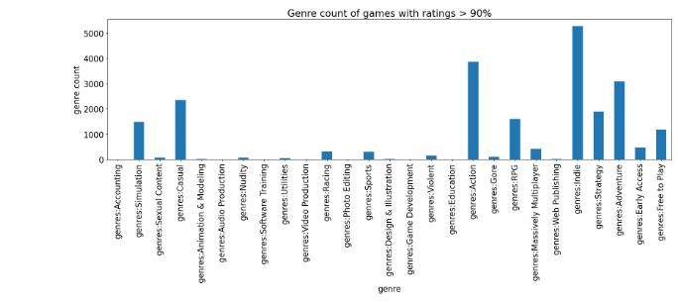

Slide 11
Data
Table 1: Summary Statistics
---------------------------------------------------------------
mean sd min max
----------------------------------------------------------------
positive_r~s 3127.586 33835.92 0 2644404
achievements 42.50324 284.1896 0 9821
average_pl~e 451.1197 3214.551 0 190625
negative_r~s 651.906 7638.706 0 487076
price 7.117333 8.25545 0 78.99
num_platfo~s 1.649251 .8466294 1 3
genresfree~y .1401109 .3471225 0 1
genresearl~s .0556669 .2292909 0 1
----------------------------------------------------------------
N 8479
----------------------------------------------------------------

Slide 12
Empirical Strategy

Slide 13
The models
positive_ratings=β0+β1achievements+β2negative_ratings+β3price+β4i.num_platforms+β5average_playtime+ui
Or can be seen as alternatively
positive_ratings = β0 + β1xi + ηZit + ui
where xi is the variable of interest(achievements), Zi is a vector of covariates (negative_ratings, price, i.num_platforms, average_playtime), and ui is the error term.

Slide 14
OLS and WLS

Slide 15
OLS and WLS
Standard errors in parentheses
* p < 0.10, ** p < 0.05, *** p < 0.01

Slide 18
Results summarized

Slide 19
Conclusions

